Slide 1
Yr 11 ATAR Chemistry
Introduction

Slide 2
Books
Pearson 11 Chemistry (also online)
Lucarelli
STAWA

Slide 3
Year 11 Chemistry Topics
Topic 1: Properties and Atomic Structure
Topic 2: Bonding and Intermolecular Forces
Topic 3: Carbon Chemistry and Energy
Topic 4: Rate of Reaction and Acids and Bases

Slide 4
Term 1 - assessments
CAP 1 (Monday Week 4)
Task 1: Practical Laboratory Validation 5%
Task 6: Atomic Models and Nanomaterials 5%
CAP 2 (Week 9)
Task 8: Topic Test 1 and Topic Test 2 7.5%

Slide 5
Prerequisite Quiz
Write the symbols for the following:
Nitrate ion
Sulfate ion
Phosphate ion
Nitrogen dioxide
Hydrogencarbonate ion
Tin (IV) oxide

Slide 6
Essential Chemistry skills

Slide 7
Essential chemistry skills
The atom (protons, neutrons and electrons)
Writing chemical formulae (ionic compounds and covalent molecules)
Balancing chemical equations
The mole concept

Slide 8
The mole

Slide 9
Relative mass
Relative atomic mass (A_{r}):
the atomic mass relative to a ¹²C atom
Relative molecular mass (M_{r}):
the mass of one molecule of the substance on a scale in which the mass of an atom of the carbon-12 isotope is exactly 12.
Sum of relative atomic masses as given by the molecular formula
E.g. M_{r} (H₂O) = 18.016

Slide 10
The Avogadro Constant (N_{A})
N_{A} : the number of atoms in exactly 12 grams of ¹²C isotope.
N_{A} = 6.022 x 10²³

Slide 11
The mole
There are 6.022 x 10²³ molecules/atoms in 1 mole
6.022 x 10²³ molecules mol⁻¹

Slide 12
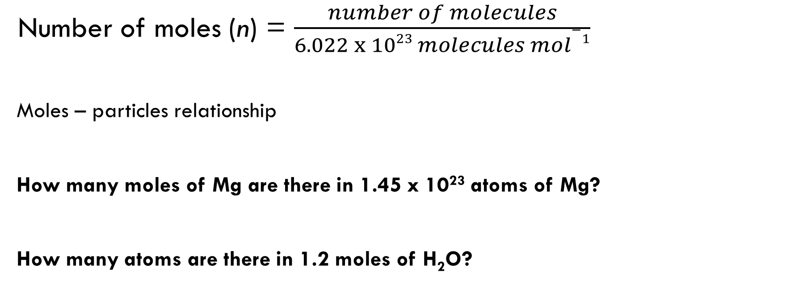
Particles and moles
Number of moles (n) = $\frac{number of molecules}{6.022 x 1023 molecules mol−1}$
Moles – particles relationship
How many moles of Mg are there in 1.45 x 10²³ atoms of Mg?
How many atoms are there in 1.2 moles of H₂O?

Slide 13
Mass and moles
If there are 6.022 x 10²³ atoms in 12 g of ¹²C and also in one mole, what is the mass of one mole of ¹²C?
What is the mass of one mole of H₂O?
Use the relative molecular mass

Slide 14
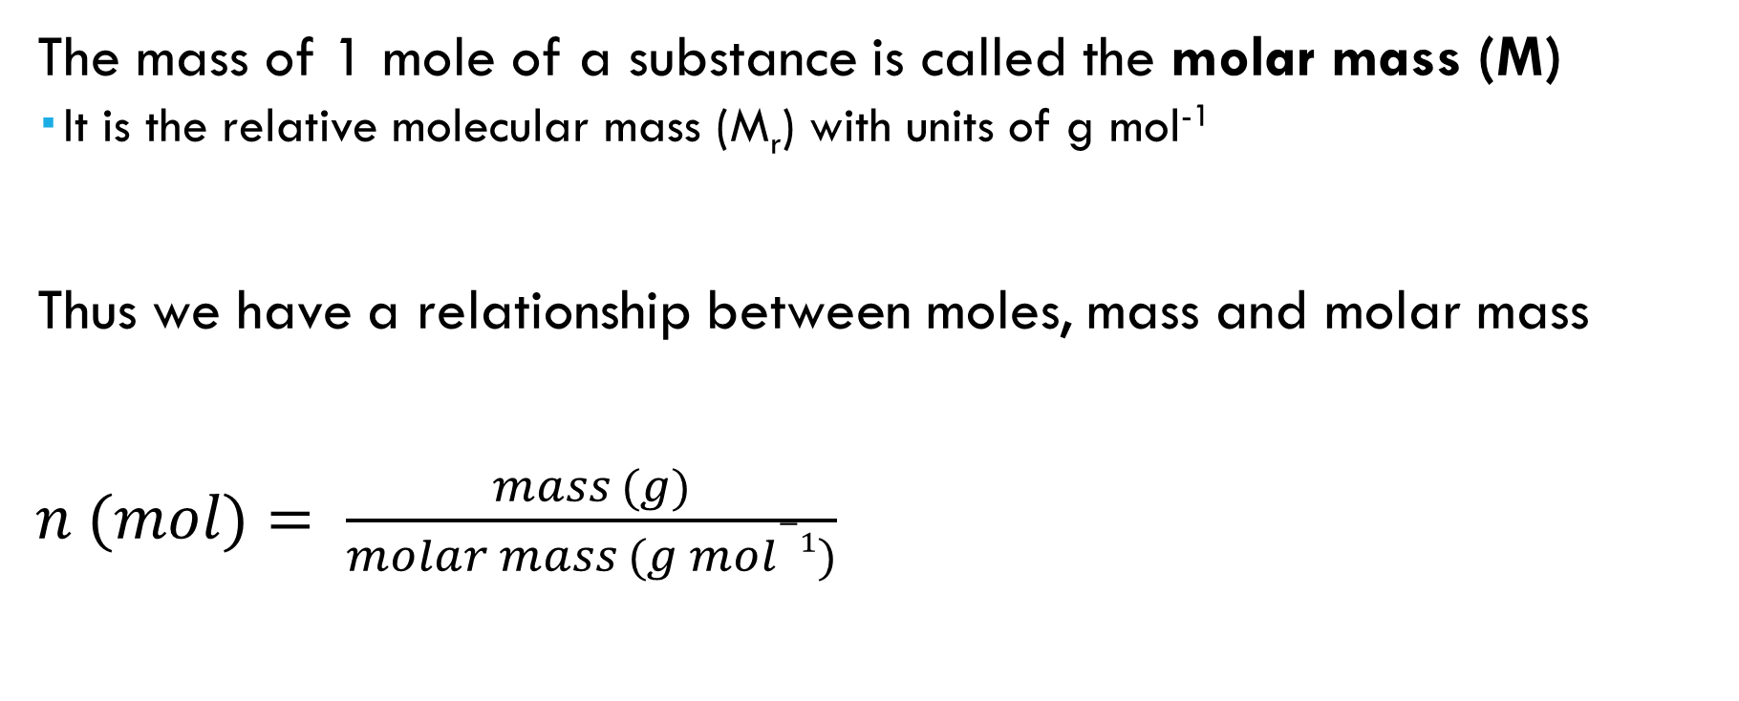
Moles and mass
The mass of 1 mole of a substance is called the molar mass (M)
It is the relative molecular mass (M_{r}) with units of g mol⁻¹
Thus we have a relationship between moles, mass and molar mass
$n (mol)= \frac{mass (g)}{molar mass (g mol−1)}$

Slide 15
Equations!
Calculate the mass of 1 mol of ethane, C₂H₆
How many moles of copper(II) sulfate CuSO₄ are there in 12.2 g copper (II) sulfate?
What is the mass of 0.75 mol of NaOH?

Slide 16
Write the correct formula for the following: silver chloride, dinitrogen monoxide, calcium carbonate, barium hydroxide, water, rhenium (I) sulfate.
Write a balanced equation with state symbols for the reaction of nickel (II) nitrate and aqueous potassium carbonate, to produce solid nickel (II) carbonate and aqueous potassium nitrate.
Calculate the number of atoms present in 12.34 g of tin (IV) phosphate.
Quercitrin is a natural dye found in North American white oaks, and has the chemical formula of C₂₁H₂₀O₁₁.
Write a balanced equation for the combustion of quercitrin in excess oxygen gas.
Calculate the mass of carbon dioxide produced from this reaction if 1.76 g of quercitrin is combusted.

Slide 17
Textbook Practice
Lucarelli Ch1.7-1.10: Atoms and Isotopes
Lucarelli Ch 4.1-4.3: Symbols and formulae
Lucarelli 6.1-6.2: Chemical Equations
Lucarelli 10.1-10.5: Moles & Molar Mass
Pearson Ch9.1-9.3: The Mole
STAWA Set 7 Elements & Symbols
STAWA Set 13 Compounds & Formulae
STAWA Set 22 Molar Mass
STAWA Set 23 Moles, particles and mass
STAWA Set 24 Interpretation of formulae

